Slide 1
ElectricFlow/Commander Roadmap
October 2014

Slide 2
Please Note
The information contained in this presentation is the confidential information of Electric-Cloud, disclosed only under a non-expired non-disclosure agreement, and is being provided to you with the express understanding that without the prior written consent of Electric-Cloud, you may not discuss or otherwise disclose this information to any third party or otherwise make use of this information for any purpose other than for which Electric-Cloud intended.
All of the future product plans and releases described herein relate to Electric-Cloud’s current product development considerations, which are at the sole discretion of Electric-Cloud and are subject to change and/or cancellation at any time. Electric-Cloud cannot and does not provide any assurance as to whether these plans will result in any future releases of the nature described. These future product plans should not be viewed as commitments on Electric-Cloud’s part and thus should not be relied upon in customer purchase decisions.

Slide 3
Our View
1
Every Business is a Software Business
Continuous Delivery is the NEW Agile
Automation & Acceleration Are Essential
2
3

Slide 4
ElectricCommander Product Strategy
1
End-to-end continuous delivery
Reduce time to value – Apps, Apps, Apps
Community ecosystem for plugins
2
3

Slide 5
ElectricFlow - Platform + Apps
Apps
Automation Platform
(commander)
ElectricFlow
Pipeline & Release Management
Build
Test
Deploy
Deploy
Shared models and practices
Builds/Tests
Applications
Components
Environments
Pipelines/Releases
Shared visibility and flexible automation
Procedures
Workflows
Projects
Resources
Jobs
Reports
Artifacts
Enterprise-grade
High Availability
Horizontal Scalability
Traceability
Security
Multi-platform

Slide 6
ElectricCommander/Flow Roadmap
5.0 LTS*
6.0 LTS*
Backlog
Commander
Versioning (Change History, Rollback)
Deploy
Versioning
Snapshots
Native cloud env modeling
Modernize agents
Pipeline mgmt
Reporting/Dashboards
DSL
Project hierarchy
Data cleanup policies
Build-Test app
Deploy Innovation Continued
Commander
REST API, JS API
System health monitoring
Deploy
Smart deploy
Partial deployments
Notifications
Scheduled deployments
5.1 and 5.2 FR*
Commander
REST API, JS API
System health monitoring
Deploy
Smart deploy
Partial deployments
Notifications
Scheduled deployments
Maintenance
Maintenance
Maintenance
4.2.4
4.2.5
5.0.1
4.2.6
5.0.2
5.0.3
5.0.4
Q2 2014
Q3 2014
Q4 2014
Future
* LTS: Long term support FR: Feature Release

Slide 7

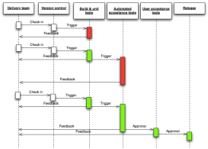


Commander 5.0
Horizontal Scalability
CI ➔ CD Platform
High Availability
Upgrades & Diagnostics
Electric Cloud Proprietary & Confidential

Slide 8
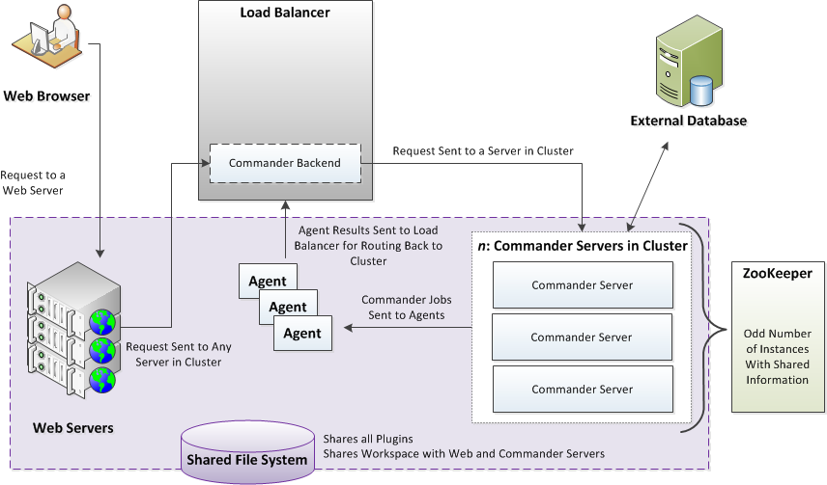
Clustering Architecture
Electric Cloud Proprietary & Confidential

Slide 9
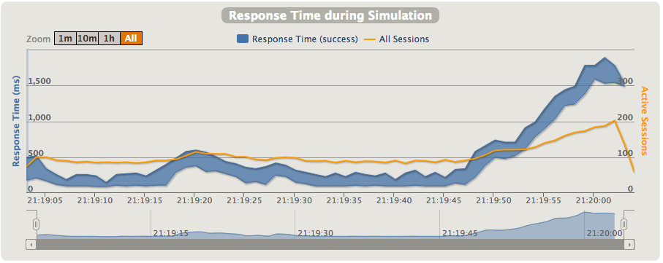
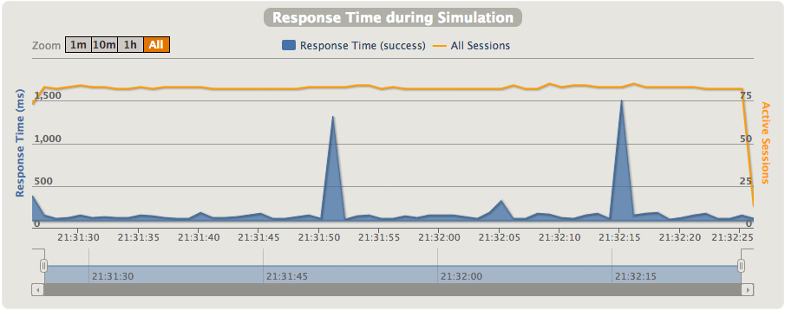
Horizontal Scalability
Single Node
75 Clients calling getJobDetails
Mean response time 436ms
Two Nodes
75 Clients calling getJobDetails
Mean response time 103ms

Slide 10
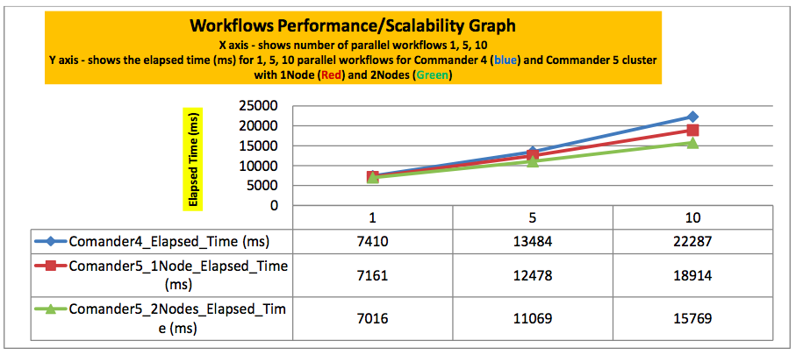
Workflow Scalability

Slide 11
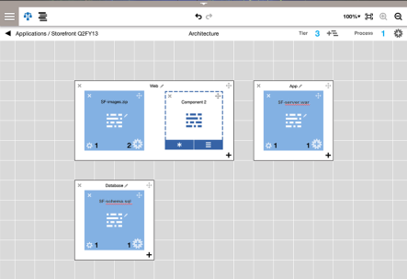
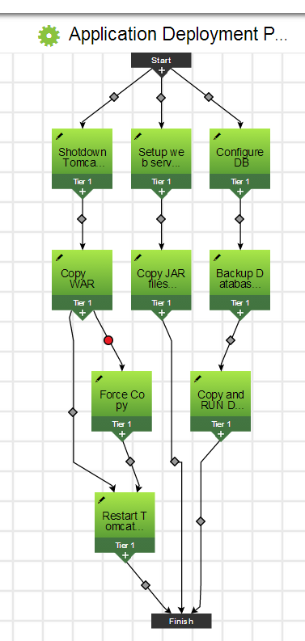
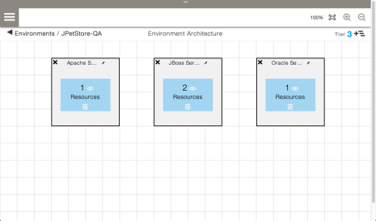
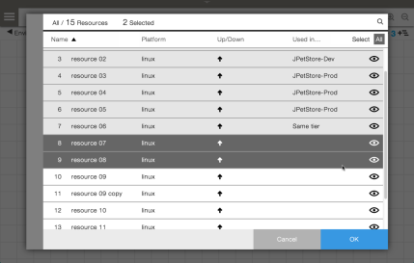
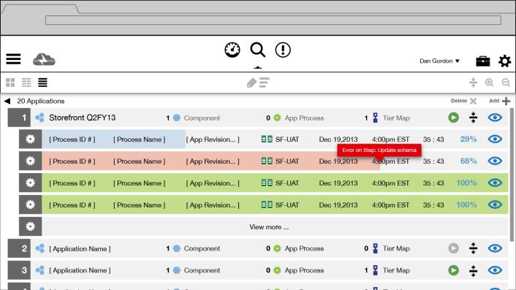
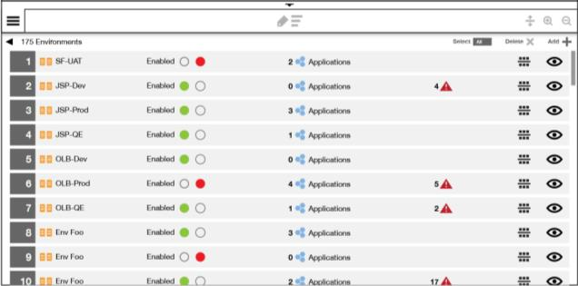
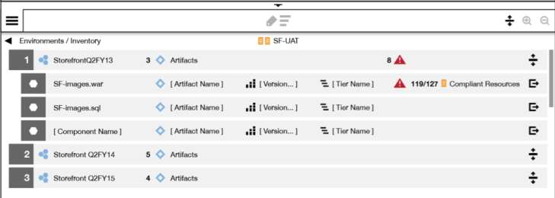
ElectricFlow Deploy Deployment Automation
Fast, self-service and push-button deployments empower all team members
Model-driven Apps and Environments promote consistency and allows reuse
Predictable deployment processes eliminate errors, allows fail-safe rollbacks
Shared visibility of everything to get insights into all deployments and what is running where
Notes:
What does model driven automation mean
It means that we model the
“what” - the application and its components
Where – the environments where the application is deployed
How – the process/workflow of deploying the application to the various environments
We have a graphical interface to model the app, env and workflow – it is very intuitive to create these models
Finally, we also provide visibility into the application deployment process.
History - Details of what happened during the deployments
Reports – Trending data of the application and for such data as failures vs success over time
Pipeline – where is the application (the environment) in the release process

Slide 12
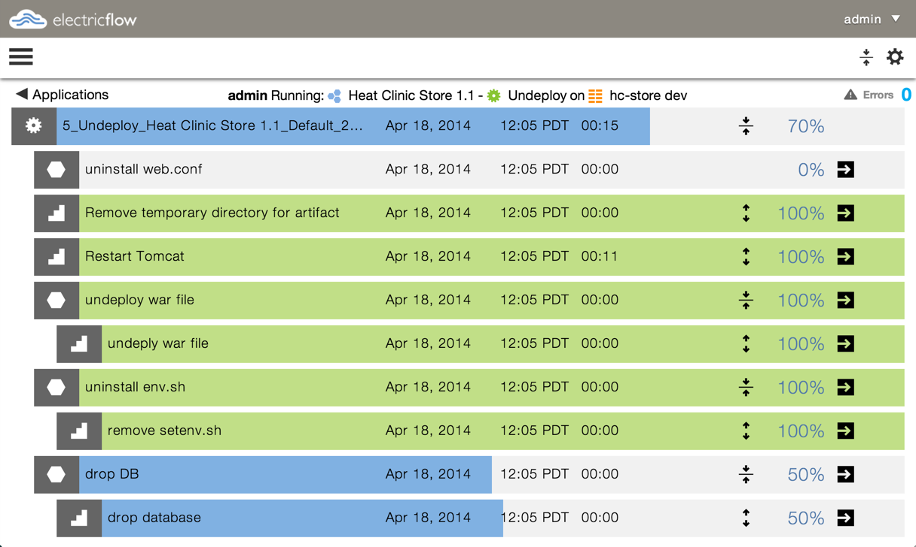
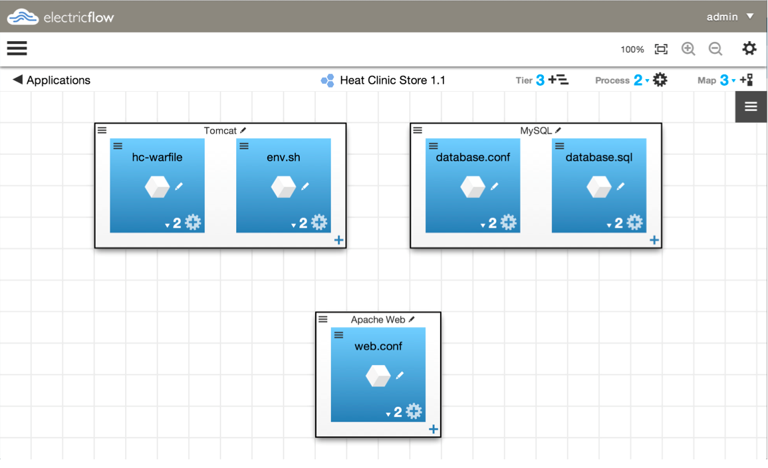
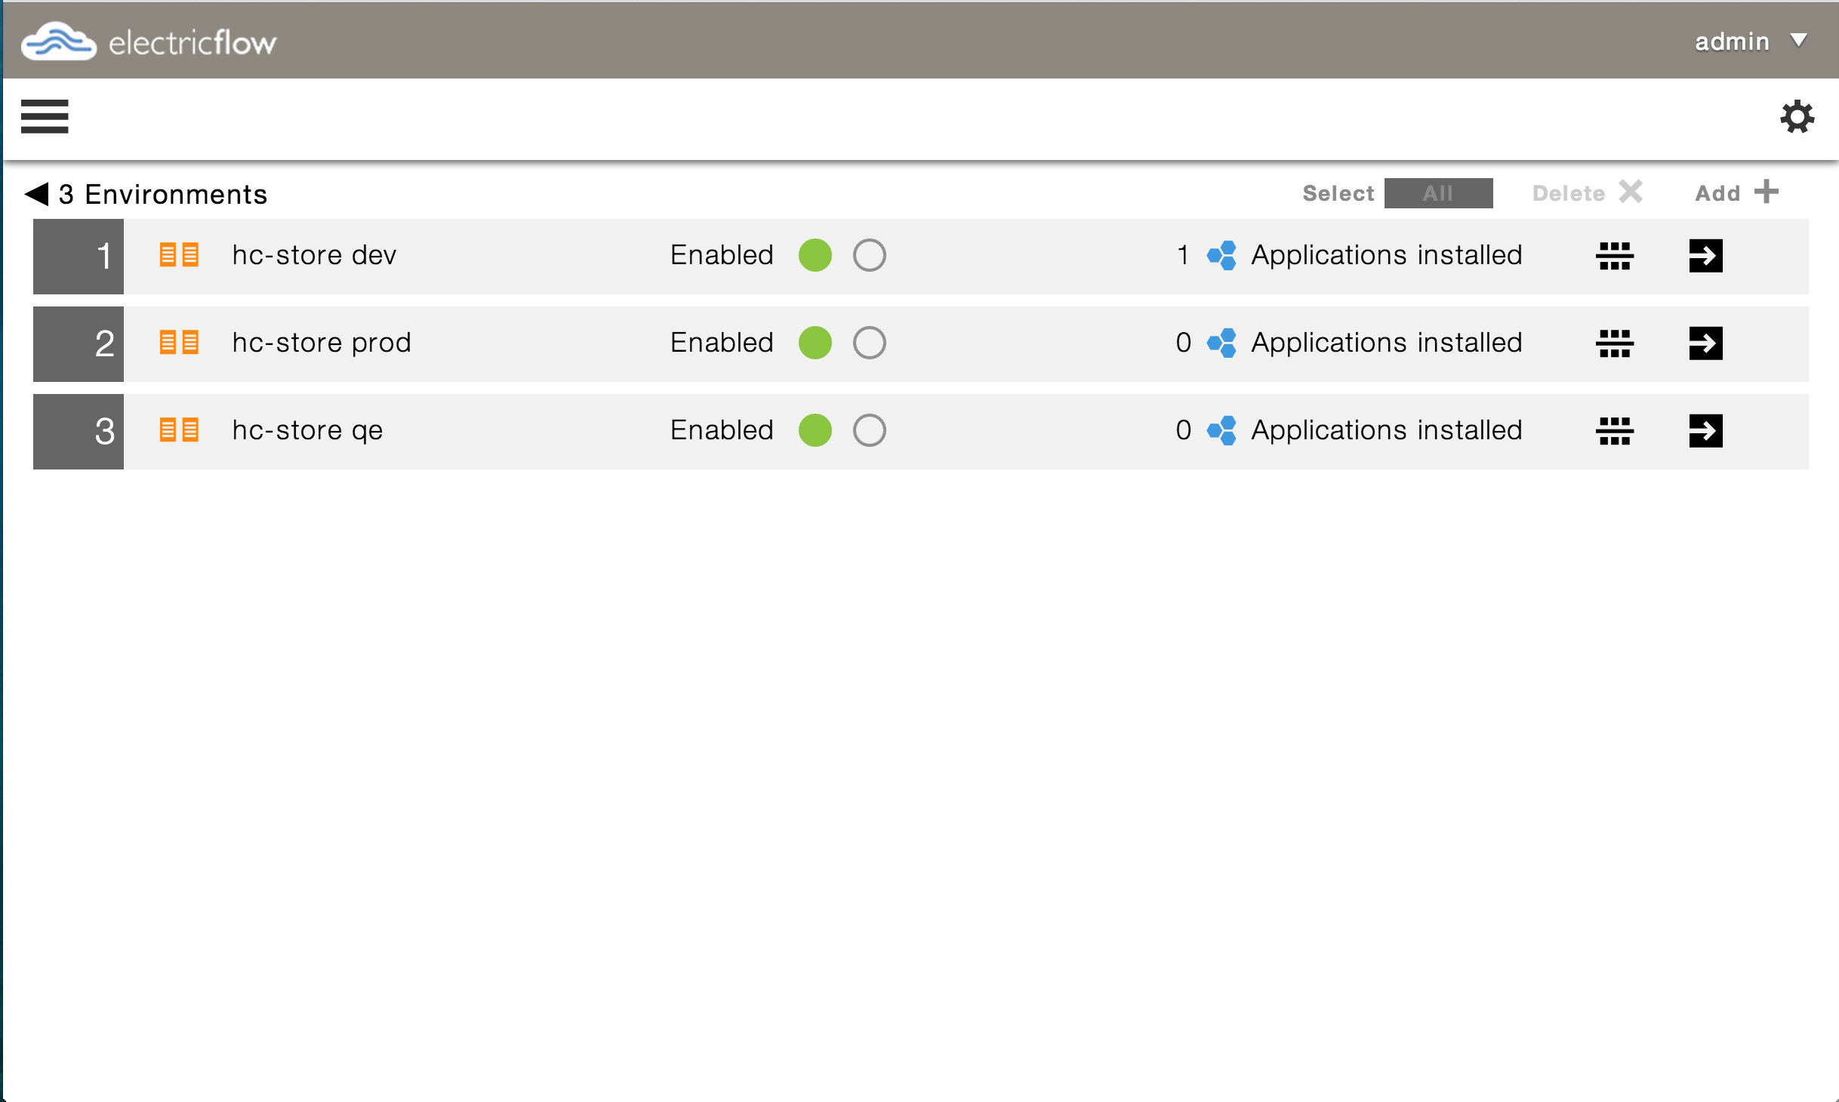
Model-Driven Deployments
Application Model
Running deployment
Environment Model

Slide 13
The How: Application Process for Repeatability
Reusable application deployment process
Reliably deploy across multiple environments
Start with what you have. Re-use existing scripts
Save time by using OOTB integrations
Dynamic behavior based on parameters and properties

Slide 14
Complete Visibility – During and After deployments
Execute deployments
Push button deploy
Real time view of deployments
What is deployed where
Track applications in environments
Track artifacts on each server

Slide 15
Introducing Feature Releases
Current:
Long term support (LTS) releases – our traditional releases
Maintenance releases
Hotfix releases
Introducing:
Feature releases
Every 60-80 days
Mainly new features. Will roll-up defect fixes
You get features sooner!
Makes LTS adoption faster
No Maintenance Releases for FR
Notes:
Sell the concept of feature releases.
We're doing CD too! FR's are a result of this. Every 45-60 days. Innovation delivered quicker. You get features sooner. Ex. 5.x out already with xyz.
Fully QA’d and fully supported release.

Slide 16
An illustration
5.0
LTS
5.1
FR
5.2
FR
6.0
LTS
6.1
FR
Main line
6.0.1
MR
All fixes of MR are always checked into the main line and are part of next FR
Maintenance line
5.0.1
MR
5.0.2
MR
5.0.3
MR
5.0.4
MR
Maintenance line
LTS: Long Term Support
FR: Feature Release
MR : Maintenance Release
HR : Hotfix Release as needed
Notes:
All the fixes are always checked into the main line
If you are on a feature release, look ‘back to left’ to know which fixes are in
That is, 5.1 and 5.2 have fixes till 5.0.1 and some that aren't released in 5.0.2
5.2 customers need to wait till 5.3 for all the fixes done in 5.0.2
Customers can upgrade to a feature release from maintenance line
That is, customers can upgrade from 5.0.2 to 5.3
This means no DB schema changes on maintenance line
Customers can upgrade from a feature release to next

Slide 17
ElectricCommander/Flow Roadmap
5.0 LTS*
6.0 LTS*
Backlog
Commander
Versioning (Change History, Rollback)
Deploy
Versioning
Snapshots
Native cloud env modeling
Modernize agents
Pipeline mgmt
Reporting/Dashboards
DSL
Project hierarchy
Data cleanup policies
Build-Test app
Deploy Innovation Continued
Commander
REST API, JS API
System health monitoring
Deploy
Smart deploy
Partial deployments
Notifications
Scheduled deployments
5.1 and 5.2 FR*
Commander
REST API, JS API
System health monitoring
Deploy
Smart deploy
Partial deployments
Notifications
Scheduled deployments
Maintenance
Maintenance
Maintenance
4.2.4
4.2.5
5.0.1
4.2.6
5.0.2
5.0.3
5.0.4
Q2 2014
Q3 2014
Q4 2014
Future
* LTS: Long term support FR: Feature Release

Slide 18
Key 5.2 capabilities
Easier integrations through RESTful API
Full functional RESTful API for the system
Integrate using programming language of your choice
http://electric-cloud.com/blog/2014/10/rest-support-electricflow-electriccommander-5-2/
Visibility into server activity though System Health Monitoring
StatsD and Graphite integration
Monitor key metrics such as - API usage, API response times, internal queue lengths etc
Notes:
(1) Background. Running Ubuntu 12.04 LTS with 3.8 kernel. IT is pushing for a new version from time-to-time. RJ: don't want a policy. Want to set expectations that we're in a reactive mode. Message: we'd like to manage this through a quarterly roadmap exchange. we usually take about a quarter to certify a new OS. We're firming up a policy now....
(2) Background. POC emake on VM/agents are baremetal rendered good results, but 45% penalty when everything is on VMs.
Message: evaluating a "performance lab" - not committing to date nor who will man it
(3) Background. IT has removed 32-bit libraries from their env. Our product is aware of 64-bitness but we require 32-bit utilities (e.g. 3clock/cmtool, Mohan has full list)
Message: on backlog

Slide 19
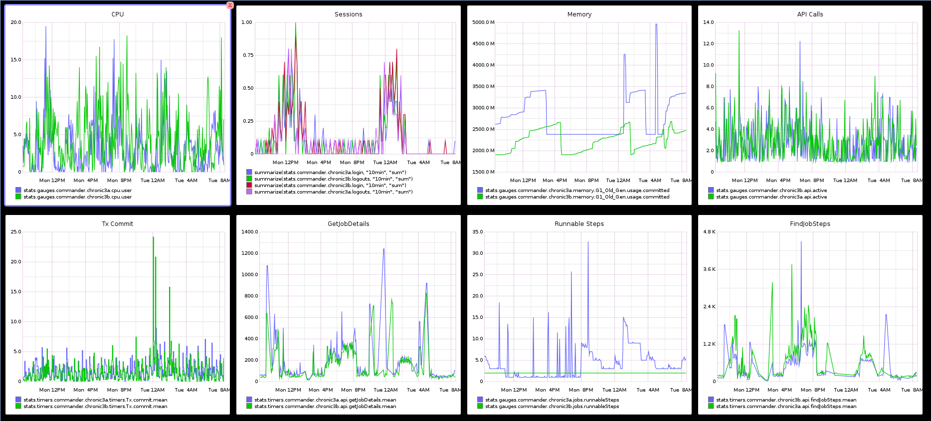
System Health Monitoring

Slide 20
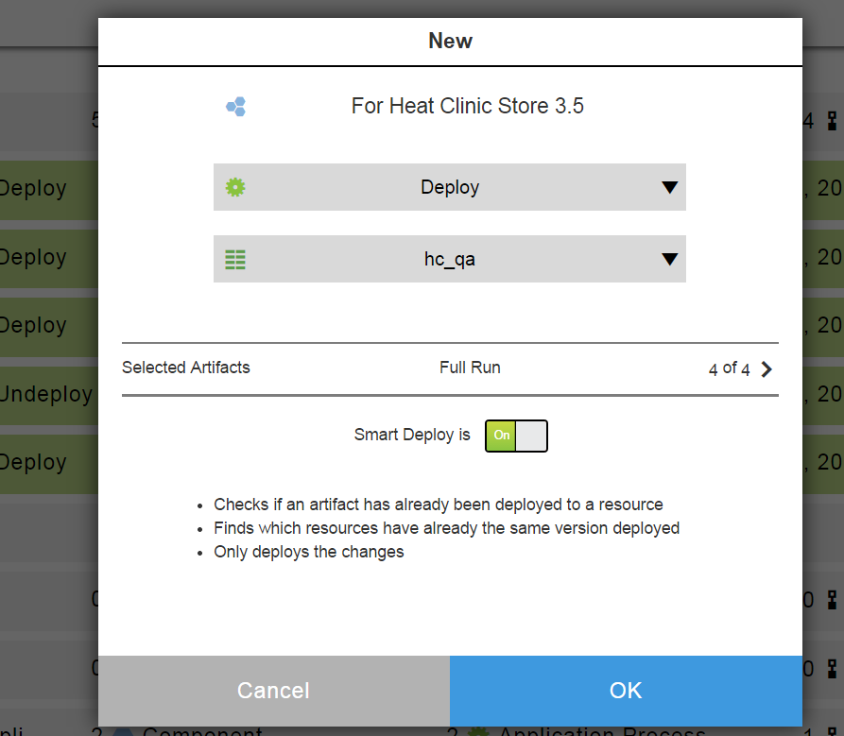
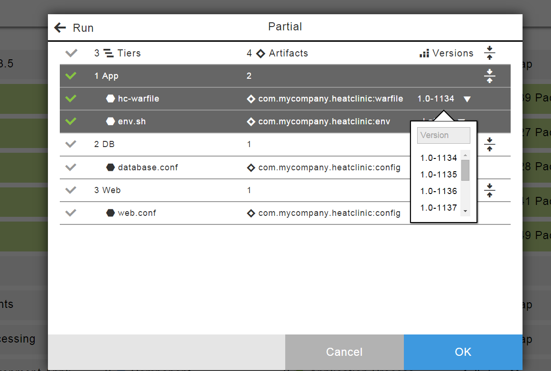
Smart Deployments with manual override
Lowered risk and faster deployments
Automatically detect delta with what is already on the environment
Deploy only what is needed
Complete control over what is deployed
Manually override exact versions to be deployed if needed
Select/unselect components to deploy

Slide 21
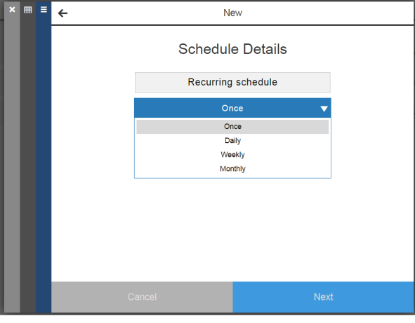
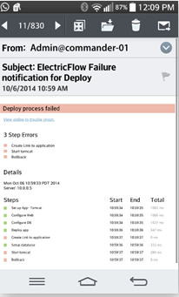
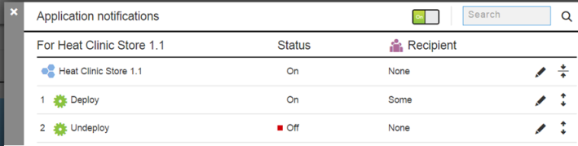
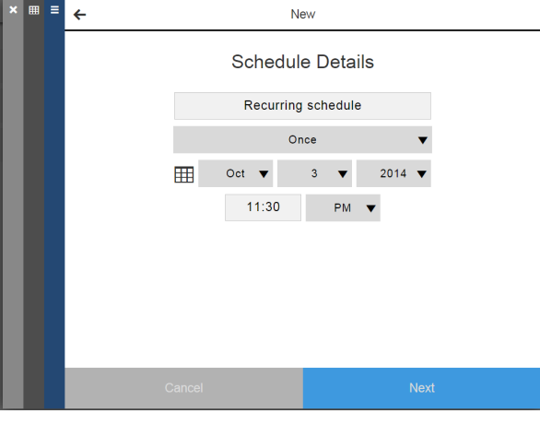
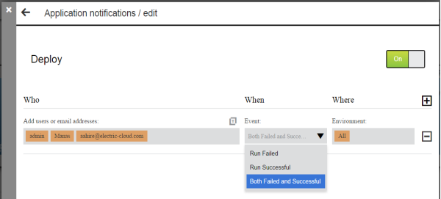
Schedules and Notifications
Unattended deployments
Schedule deployments
One time or recurring
Deployment Notifications
Proactively know success/failures
Quickly triage issues

Slide 22
ElectricCommander/Flow Roadmap
5.0 LTS*
6.0 LTS*
Backlog
Commander
Versioning (Change History, Rollback)
Deploy
Versioning
Snapshots
Native cloud env modeling
Modernize agents
Pipeline mgmt
Reporting/Dashboards
DSL
Project hierarchy
Data cleanup policies
Build-Test app
Deploy Innovation Continued
Commander
REST API, JS API
System health monitoring
Deploy
Smart deploy
Partial deployments
Notifications
Scheduled deployments
5.1 and 5.2 FR*
Commander
REST API, JS API
System health monitoring
Deploy
Smart deploy
Partial deployments
Notifications
Scheduled deployments
Maintenance
Maintenance
Maintenance
4.2.4
4.2.5
5.0.1
4.2.6
5.0.2
5.0.3
5.0.4
Q2 2014
Q3 2014
Q4 2014
Future
* LTS: Long term support FR: Feature Release

Slide 23
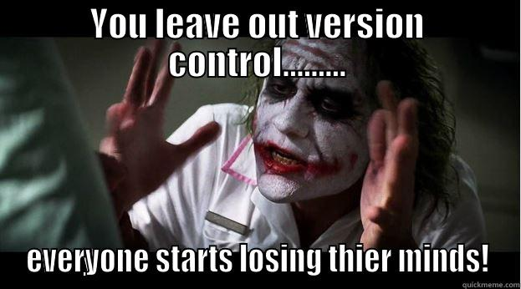
Versioning

Slide 24
Key problems
I am worried that I or someone new might break things
What just changed that broke things? Who changed it? When?
Something just broke after recent changes, how do I go rollback to when things were working fine
How can I compare multiple copies of the same object to better understand what exactly has changed
Multiple users can work on the same thing at the same time, potentially overwriting each others work
Can I have multiple copies of the same object ‘live’ at the same time?

Slide 25

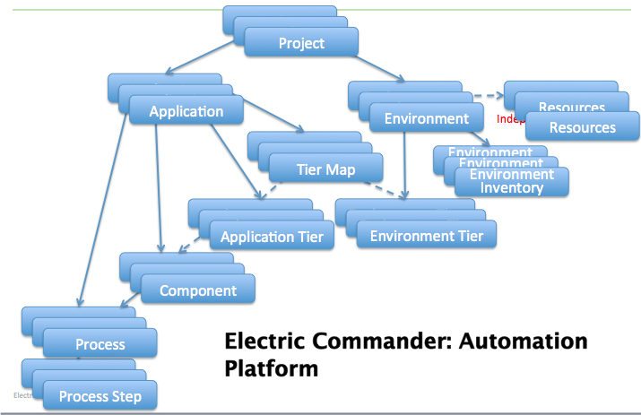
Change Tracking
Ability to view who changed what at the entity level ( eg: step), or at the entire object hierarchy level ( eg: Projects )
Ability to view who changed what of all the entities used by failed job or workflow
List of change Tracked objects can be configured
Ability to label historical state of Projects, Procedure, Applications and Workflows at any point in time
Ability to export historical state of an object hierarchy based on a date or label
ElectricFlow
Ability to Rollback to a historical state of an object or at a granular entity level based on a date or label
Ability to view change tracked records based on date or label
Ability to Turn or off Change Tracking
Ability to exclude properties at a property sheet level to limit change tracking of dynamic Properties
Notes:
Question: Ability to create exclusive locks on objects at a very granular level
I want to be able to disable change tracking for the portion of the object hierarchy owned by a specific project since I frequently run jobs that create news steps or procedures inside that project, so that I can save database space
Revision -

Slide 26
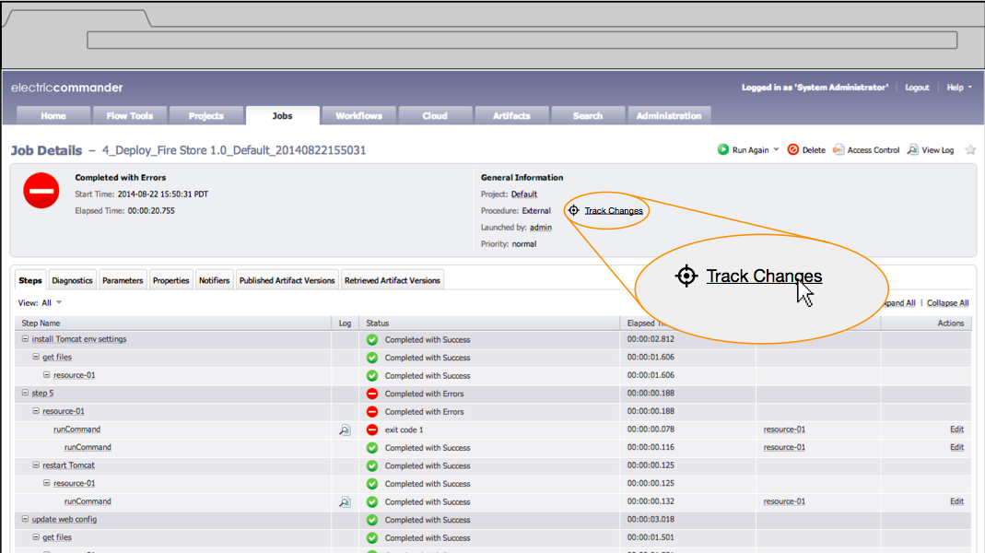
Commander 6.0

Slide 27
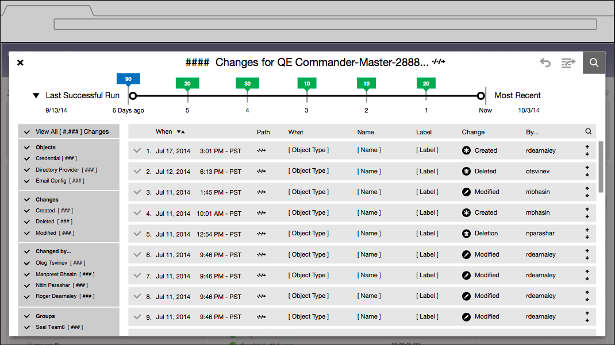
Commander 6.0

Slide 28
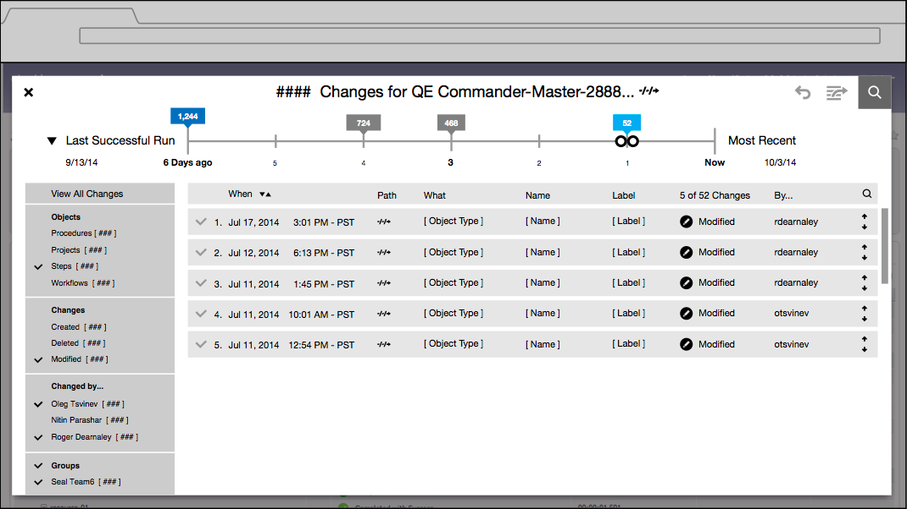
Commander 6.0

Slide 29
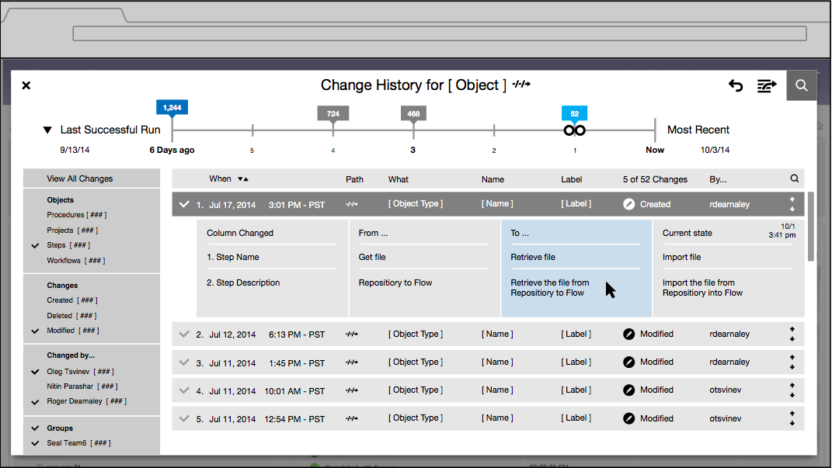
Commander 6.0

Slide 30
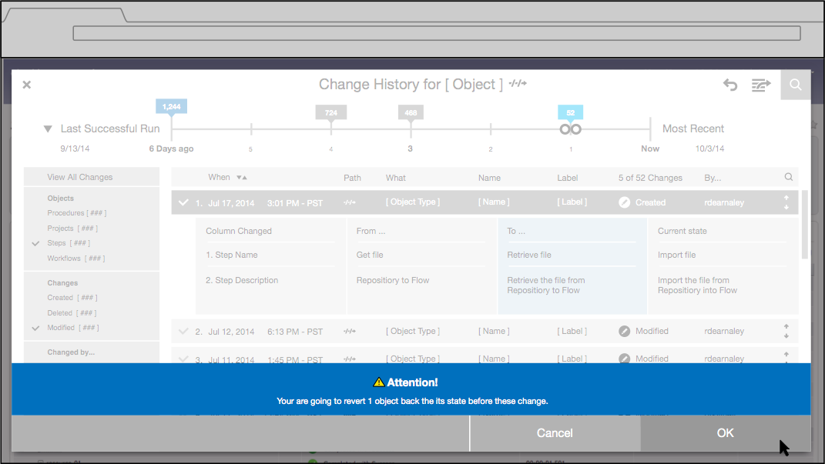
Commander 6.0

Slide 31
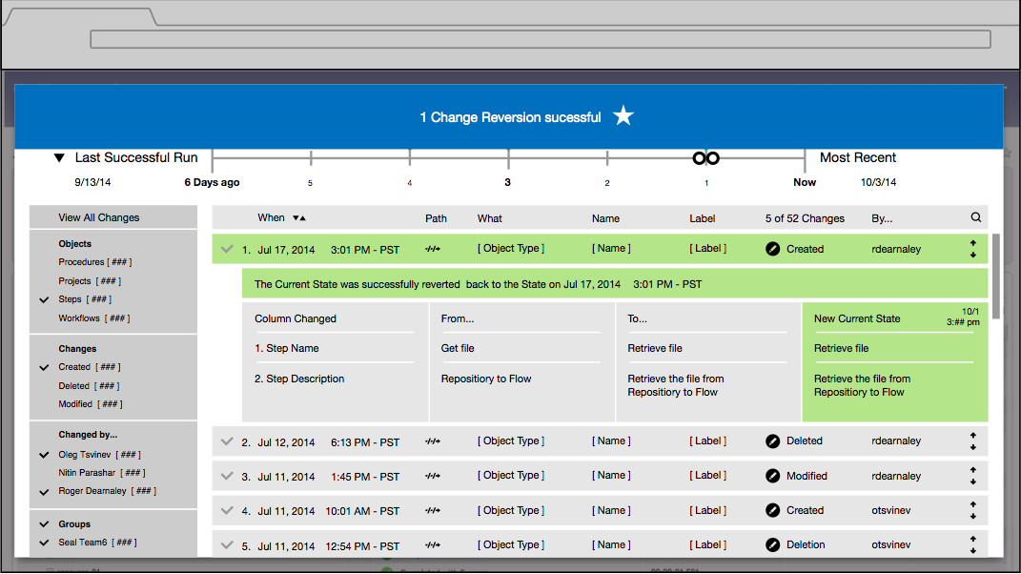
Commander 6.0

Slide 32
Insert Slides for Snapshots and Dynamic Env

Slide 33
ElectricCommander/Flow Roadmap
5.0 LTS*
6.0 LTS*
Backlog
Commander
Versioning (Change History, Rollback)
Deploy
Versioning
Snapshots
Native cloud env modeling
Native 64 bit agents
Hierarchical Projects
Data cleanup policies
Reporting/Dashboards
Domain Specific Lang
Commander UI enhancements
Pipeline mgmt app
Build-Test app
Deploy Innovation Continued
Commander
REST API, JS API
System health monitoring
Deploy
Smart deploy
Partial deployments
Notifications
Scheduled deployments
5.1 and 5.2 FR*
Commander
REST API, JS API
System health monitoring
Deploy
Smart deploy
Partial deployments
Notifications
Scheduled deployments
Maintenance
Maintenance
Maintenance
4.2.4
4.2.5
5.0.1
4.2.6
5.0.2
5.0.3
5.0.4
Q2 2014
Q3 2014
Q4 2014
Future
* LTS: Long term support FR: Feature Release

Slide 34
ElecricCommander Roadmap
Modernize Agents
64 bit agents
Support agents on more platforms
Simplify Agent installation
Reporting/Dashboards
Reporting and Dashboards framework
Key out of the box reports, dashboards
Notes:
(1) Background. Running Ubuntu 12.04 LTS with 3.8 kernel. IT is pushing for a new version from time-to-time. RJ: don't want a policy. Want to set expectations that we're in a reactive mode. Message: we'd like to manage this through a quarterly roadmap exchange. we usually take about a quarter to certify a new OS. We're firming up a policy now....
(2) Background. POC emake on VM/agents are baremetal rendered good results, but 45% penalty when everything is on VMs.
Message: evaluating a "performance lab" - not committing to date nor who will man it
(3) Background. IT has removed 32-bit libraries from their env. Our product is aware of 64-bitness but we require 32-bit utilities (e.g. 3clock/cmtool, Mohan has full list)
Message: on backlog

Slide 35
ElecricCommander Roadmap
Data cleanup policies
Rules for data retention
Proactively cleanup old jobs, workspace files etc
Faster system performance
Hierarchical Projects
Organize various objects
Easier management of access control and other policies
Notes:
(1) Background. Running Ubuntu 12.04 LTS with 3.8 kernel. IT is pushing for a new version from time-to-time. RJ: don't want a policy. Want to set expectations that we're in a reactive mode. Message: we'd like to manage this through a quarterly roadmap exchange. we usually take about a quarter to certify a new OS. We're firming up a policy now....
(2) Background. POC emake on VM/agents are baremetal rendered good results, but 45% penalty when everything is on VMs.
Message: evaluating a "performance lab" - not committing to date nor who will man it
(3) Background. IT has removed 32-bit libraries from their env. Our product is aware of 64-bitness but we require 32-bit utilities (e.g. 3clock/cmtool, Mohan has full list)
Message: on backlog

Slide 36
ElecricCommander Roadmap
Domain Specific Language
Process as a code
Interact using DSL!
EXAMPLE
project("test") {
procedure("procedure name") {
step("checkout") {
command = "xyz"
}
step("build") {
command = "gradle build"
}
step("unit test") {
parallel = true
subproject = "test project"
subprocedure = "unit test" // no parameters
errorHandling = "ignore"
customProperty = "custom value"
}
Notes:
(1) Background. Running Ubuntu 12.04 LTS with 3.8 kernel. IT is pushing for a new version from time-to-time. RJ: don't want a policy. Want to set expectations that we're in a reactive mode. Message: we'd like to manage this through a quarterly roadmap exchange. we usually take about a quarter to certify a new OS. We're firming up a policy now....
(2) Background. POC emake on VM/agents are baremetal rendered good results, but 45% penalty when everything is on VMs.
Message: evaluating a "performance lab" - not committing to date nor who will man it
(3) Background. IT has removed 32-bit libraries from their env. Our product is aware of 64-bitness but we require 32-bit utilities (e.g. 3clock/cmtool, Mohan has full list)
Message: on backlog

Slide 37
Insert Slides for Pipeline

Slide 38

Thank You!

Slide 39
Electric Cloud Product & Process Evolution
Enterprise readiness improvements | Performance and scalability testing lab High availability and horizontal scalability features System health monitoring
Quality advances | Robust release checklist Track third party dependencies Automated tests for customer reported defects Increase in test automation & coverage Security scanning using Nexpose (Rapid7)
Customer support | Level 3 support process Customer responsiveness goals Establish 6-9 month cadence for major releases Maintenance releases every quarter Introduce Feature release type for fast feedback
Plug-in strategy | New plug-in development team in place First priority is fix existing plug-ins Community development for Tier 2 plug-ins

Slide 40

Plugin Support Model
Current Model
New Model
All Plugins
All Plugins
Core Plugins
Open Source Plugins
Tier 1 Plugins
EC Owns & Supports
EC Owns & Supports
Community Owns & Supports

Slide 41
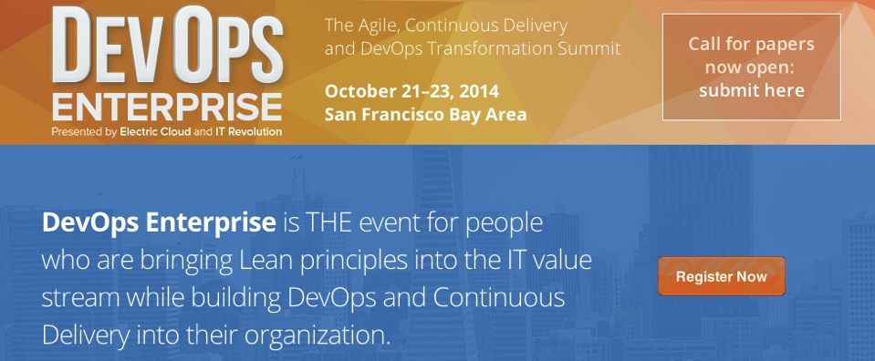

Join us
Notes:
More speed: Build avoidance: object reuse, e.g. ccache
Accelerate Bitbake: Smallest Yocto Project build is 4-5 hours serially.
Op 1: bitbake calls emake (instead of gmake) →35% gains
Op 2: Translate bitbake into a makefile, then invoke emake → research in progress.
JUnit Testrunner replacement for distributed parallel JUnit acceleration on EA cluster
Bitbake is u
sed in automotive vertical for on-board systems via the Yocto Project to build a complete Linux system image - Hundreds of packages: kernel, compilers, utilities, etc.
For each package:
Download
Unpack
Apply patches
Compile
Package
Test Considerations:
Where is test run from: Maven/ANT?
How long are your JUnit tests?
Does JUnit test execute in a separate JVMs?
Are there implicit dependencies between JUnit tests?
Have you considered using parallelism in JUnit?

